Slide 1
Data Camp for Developer
MTC Seattle
Hyun (hyssh@microsoft.com)

Slide 2
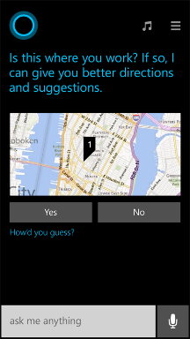
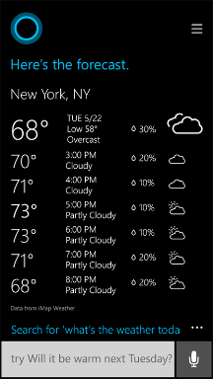
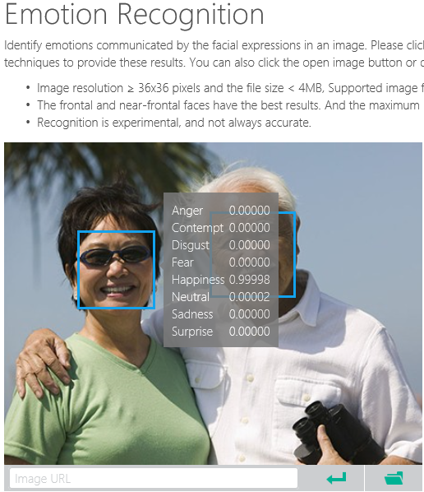
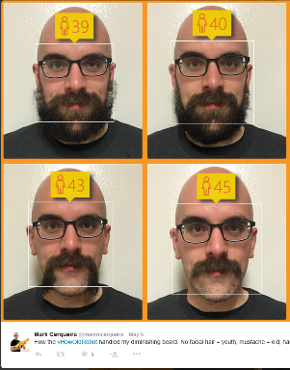
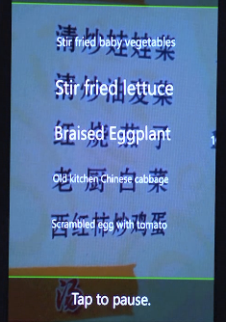
Why Machine Learning?
Notes:
Smart applications, services, platforms…
Digital Smart Personal Assistant
Image / Text / Data analyze

Slide 3
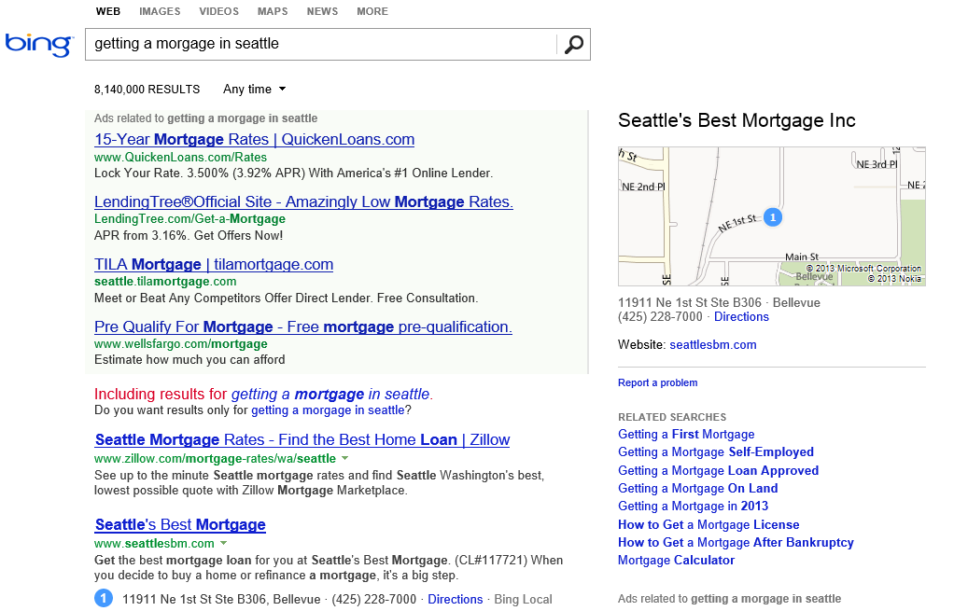
What is the probability of a click on each ad?
What language?
What is the intent?
Machine learning enables nearly every value proposition of web search.
Which ads to show, and in what order?
Are any of these pages malicious?
Misspelled?
What pages should we index?
What ad pricing will optimize revenue?
Which links are most likely to get clicked?
Notes:
The first “killer commercial application” of ML on Big Data was web search. With ML, we can use all of the billions of queries and associated clicks that we collect each month as training data for an ML system. That way, the system can learn, for each query, which web pages are likely the most relevant.
But the impact of ML goes beyond page relevance. With billions of queries, we can learn common misspellings and the native language of the user. We can discern the intent of the user – shopping? research? entertainment? ML can learn what kinds of pages are malicious.
ML also is able to learn, for each query, what kinds of ads are most likely to be clicked, and also learn how best to show the ads.
And even before we get to a real user, ML can be used to figure out what parts of the web are worth scanning, and what pricing for ads will optimize revenues.

Slide 4
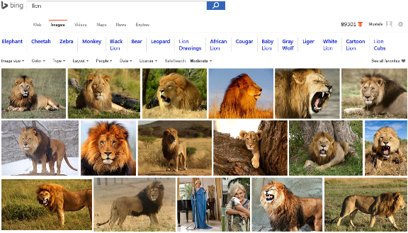
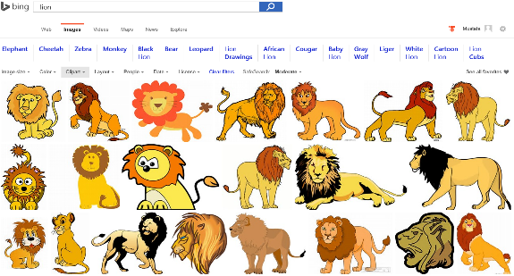
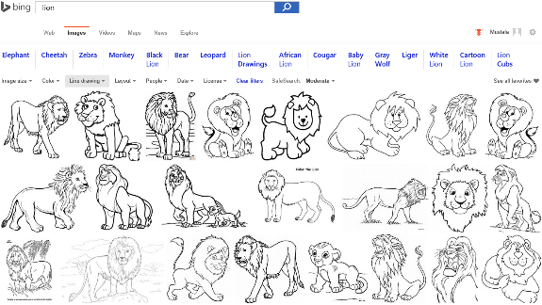
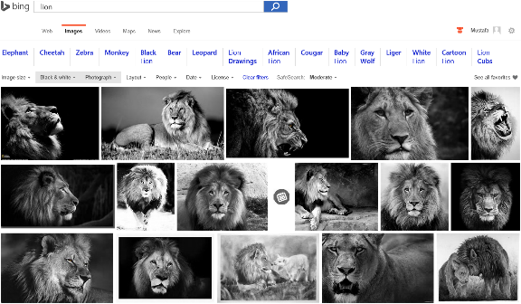
Image Analyze
Notes:
Search “lions” on Bing and change Image type etc. filters…
Behind the ML service categorizes the image db and returns the result.

Slide 5

Accent Color: Which border color is the best?
Notes:
Some another application on computer vision that meets with the machine learning

Slide 6
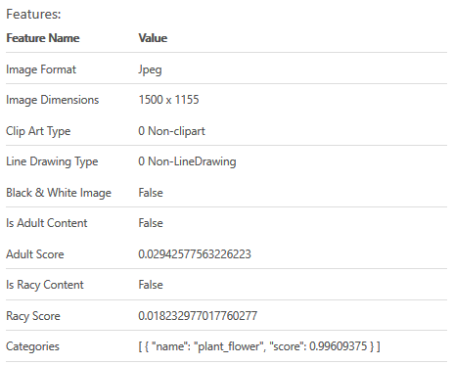

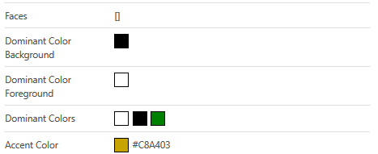
Accent Color: Analyze Image
Notes:
Goto https://www.projectoxford.ai/demo/visions#Analysis and analyze this image to find its accent color

Slide 7
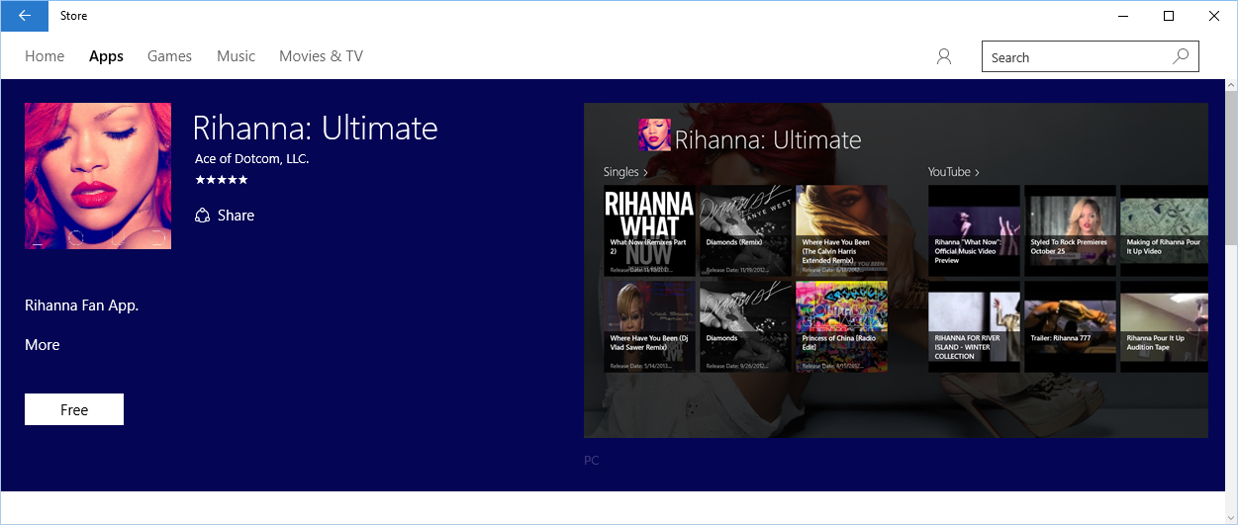
Accent Color: Windows 10 Store
Notes:
How to use accent color, case study.

Slide 8
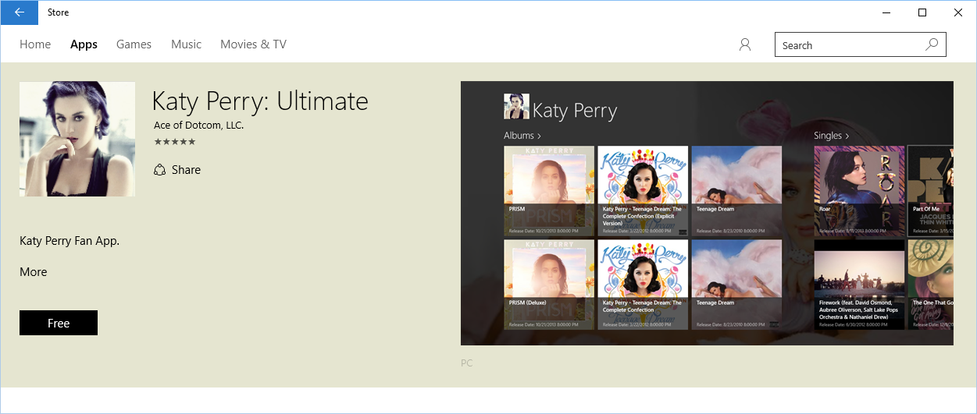
Accent Color: Windows 10 Store
Notes:
How to use accent color, case study.

Slide 9
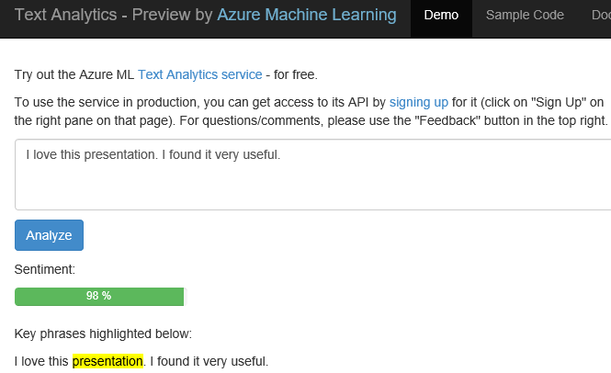
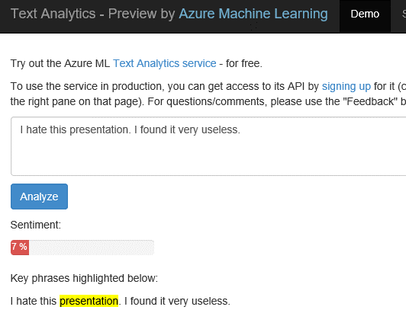
Text Analytics: User reviews
Positive
Negative
Notes:
Ready to use ML API published on Azure Datamarket place. A showcase of production ML solution in action (This can be used i.e. in shopping websites to see user reviews about a product etc.)
Test by yourself some of the reviews comments on Expedia or other online shopping sites. Copy/paste user comments to see the analyze result. If sentiment result shows higher percentage number, it means it is positive. If the percentage is low than it is a negative comment.
https://text-analytics-demo.azurewebsites.net/
https://www.microsoft.com/cognitive-services/en-us/text-analytics-api

Slide 10
Machine Learning
The Formal one:
“A computer program is said to learn from experience E with respect to some class of tasks T and performance measure P if its performance at tasks in T, as measured by P, improves with experience E.”
A Practical Example:
Look at data. Do the thing. Better? No? Look at the data. Do something different. Better? Yes? Do that again. (Repeat)

Slide 11
Agenda
Data Science
Data Science process – TDSP (Team Data Science Process)
Data Science Tools
Hands on Lab

Slide 12

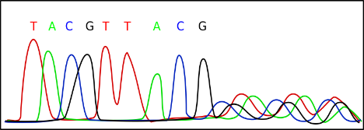
Data Science
Data science is about using data to make decision that drive actions
Five questions
Is your data ready?
Ask the right question
Predict an answer
Copy other people’s work

Slide 13
1. Five questions
Data Science
Machine Learning can answers
Is this A or B?
Is this weird?
How much? How many?
How is this organized?
What should I do?

Slide 14
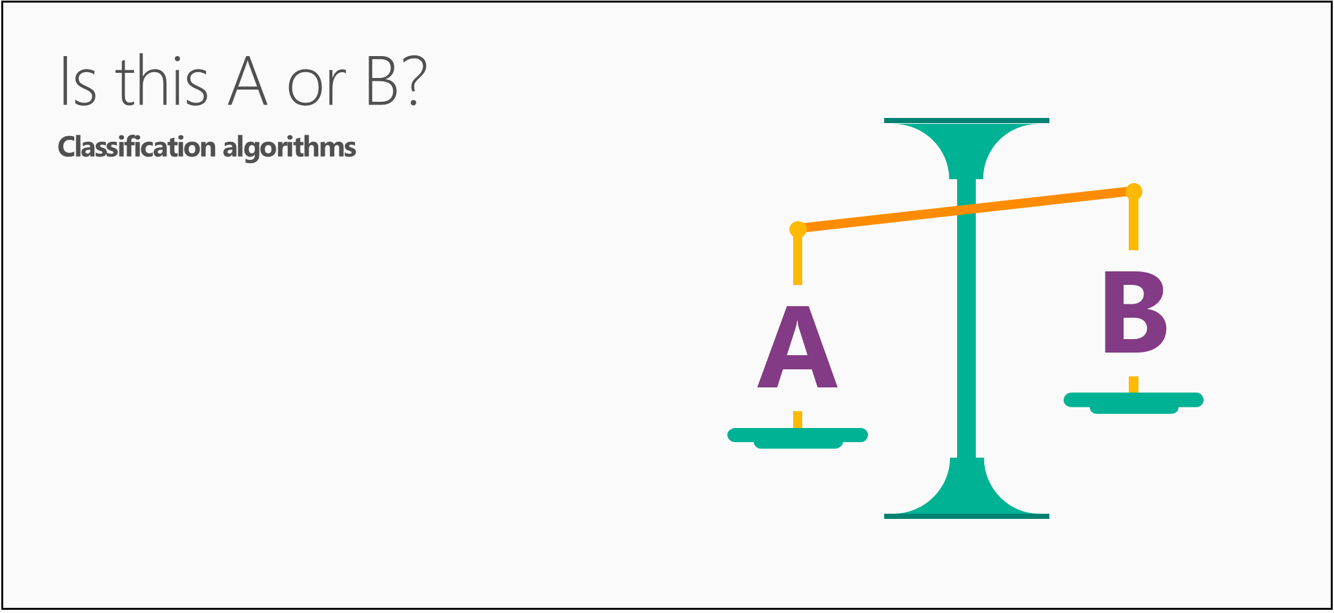
1. Five questions
Data Science

Slide 15

1. Five questions
Data Science

Slide 16
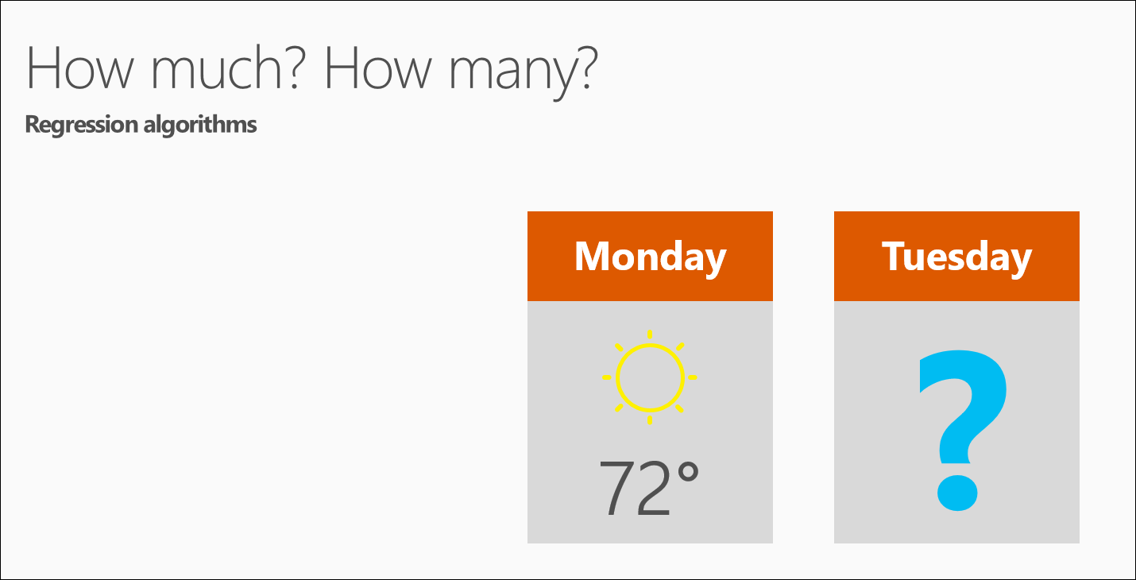
1. Five questions
Data Science

Slide 17
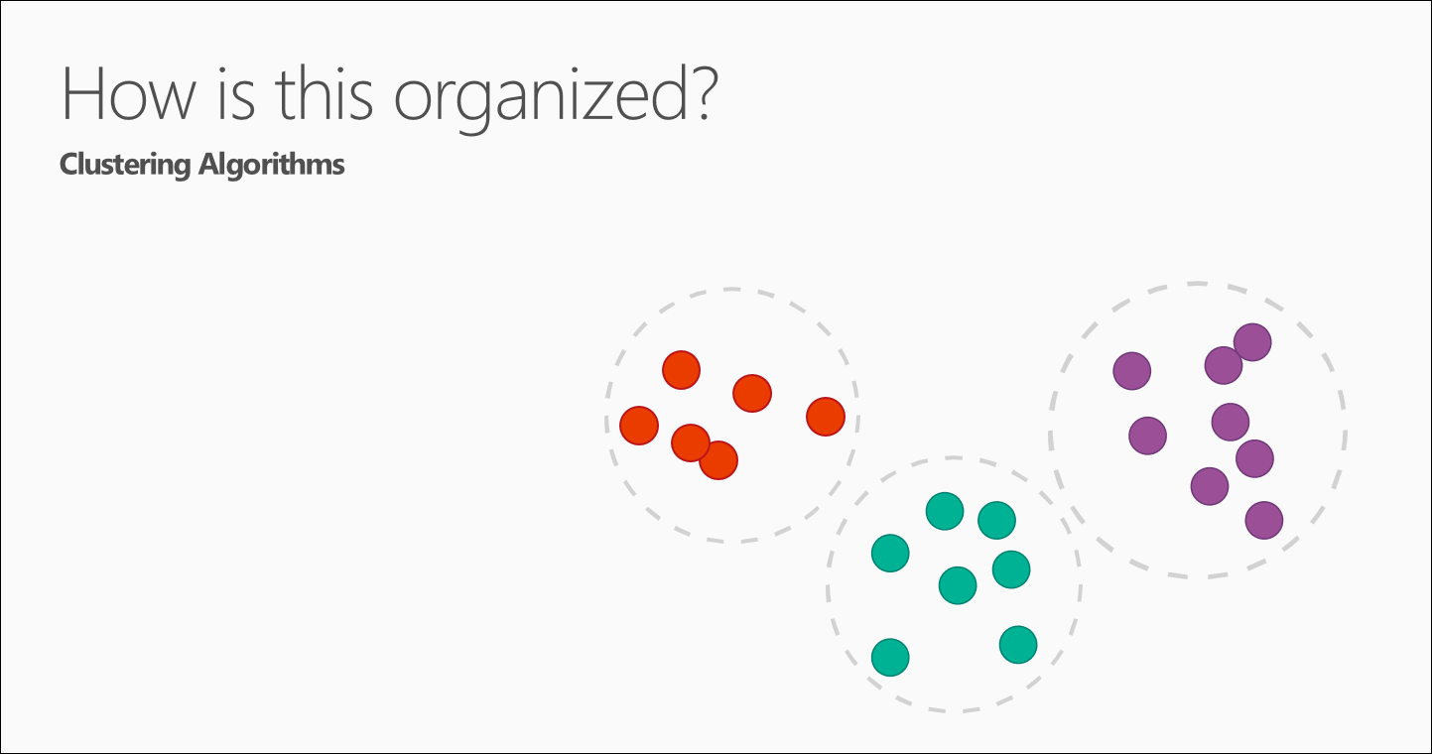
1. Five questions
Data Science

Slide 18
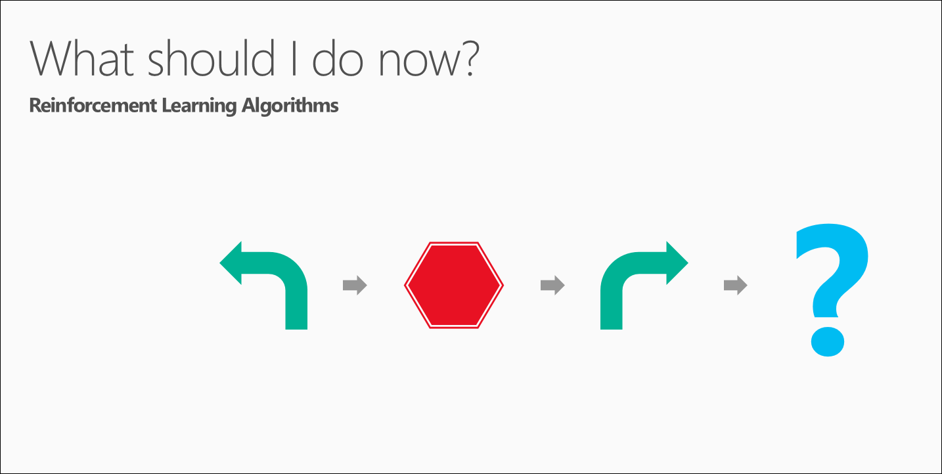
1. Five questions
Data Science

Slide 19
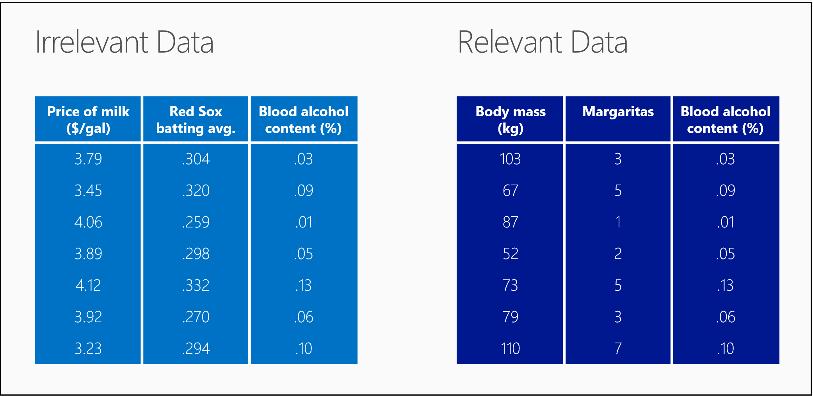
2. Is your data ready?
Data Science
Relevant
Connected
Accurate
Enough to work with

Slide 20
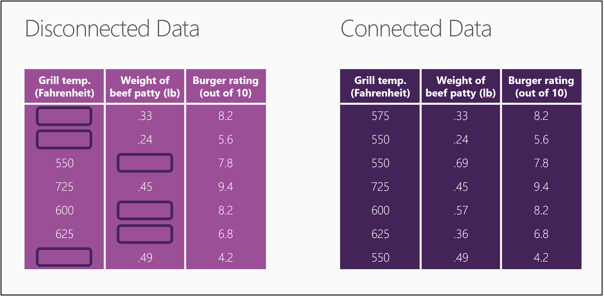
2. Is your data ready?
Data Science
Relevant
Connected
Accurate
Enough to work with

Slide 21
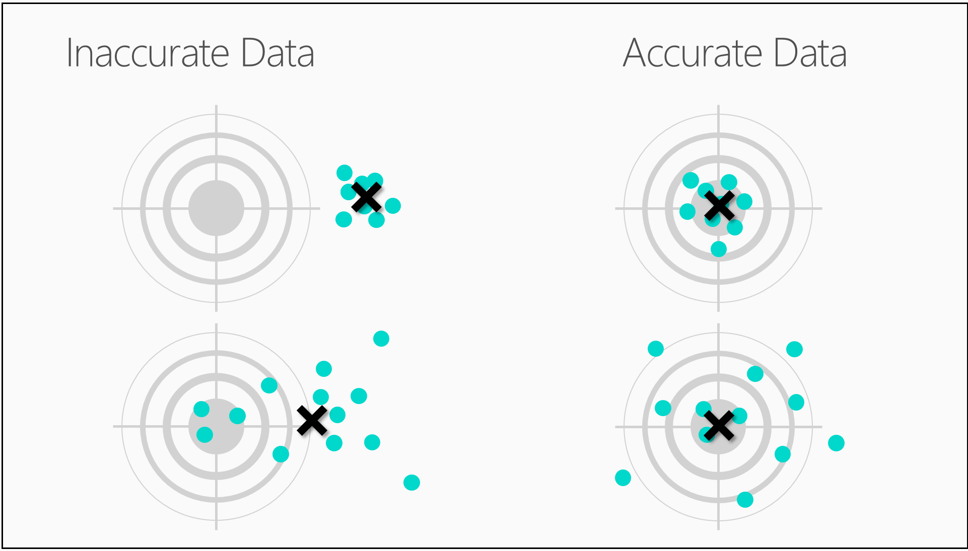
2. Is your data ready?
Data Science
Relevant
Connected
Accurate
Enough to work with

Slide 22

2. Is your data ready?
Data Science
Relevant
Connected
Accurate
Enough to work with

Slide 23

2. Is your data ready?
Data Science
Relevant
Connected
Accurate
Enough to work with

Slide 24

2. Is your data ready?
Data Science
Relevant
Connected
Accurate
Enough to work with

Slide 25

3. Ask the right question
Sharp question

Slide 26
3. Ask the right question
Data Science
Sharp question
Will this tire fail in the next 1,000 miles: Yes or no?
Which brings in more customers: a $5 coupon or a 25% discount?
If you have a car with pressure gauges, you might want to know: Is this pressure gauge reading normal?
If you're monitoring the internet, you’d want to know: Is this message from the internet typical?
What will my stock's sale price be next week?
What will the temperature be next Tuesday?
What will my fourth quarter sales be?
Which viewers like the same types of movies?
Which printer models fail the same way?

Slide 27
3. Ask the right question
Data Science
Reformulate your question

Slide 28
4. Predict an answer
Data Science
How much 1.35 carat diamond cost these days?
Carats | Price
1.01 | 7366
0.49 | 985
0.31 | 544
1.51 | 9140
0.37 | 493
0.73 | 3011
1.53 | 11413
0.56 | 1814
0.41 | 876
0.74 | 2690
0.63 | 1190
0.6 | 4172
2.06 | 11764
1.1 | 4682
1.31 | 6171

Slide 29
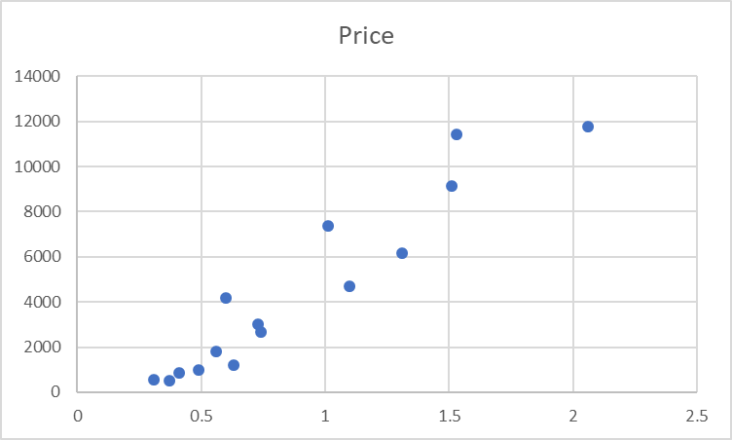
4. Predict an answer
Data Science
Understand data
Plot the existing data
Carats | Price
1.01 | 7366
0.49 | 985
0.31 | 544
1.51 | 9140
0.37 | 493
0.73 | 3011
1.53 | 11413
0.56 | 1814
0.41 | 876
0.74 | 2690
0.63 | 1190
0.6 | 4172
2.06 | 11764
1.1 | 4682
1.31 | 6171

Slide 30
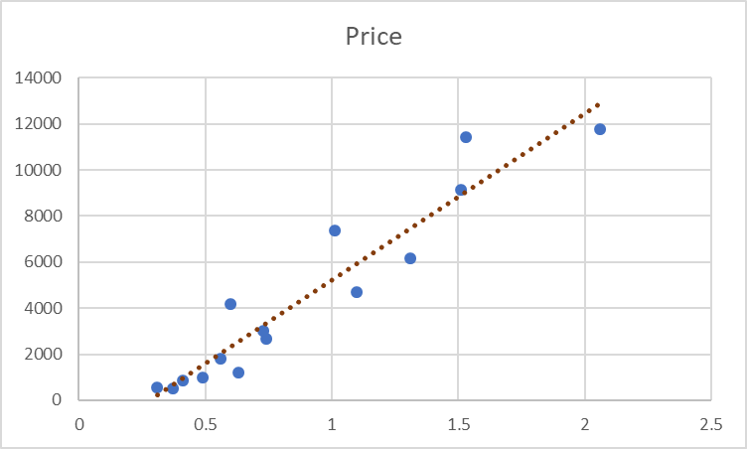
4. Predict an answer
Data Science
Create a model
Draw the model through the data points
Carats | Price
1.01 | 7366
0.49 | 985
0.31 | 544
1.51 | 9140
0.37 | 493
0.73 | 3011
1.53 | 11413
0.56 | 1814
0.41 | 876
0.74 | 2690
0.63 | 1190
0.6 | 4172
2.06 | 11764
1.1 | 4682
1.31 | 6171

Slide 31
4. Predict an answer
Data Science
Use the model to find the answer
How much 1.35 carat diamond cost these days?
Carats | Price
1.01 | 7366
0.49 | 985
0.31 | 544
1.51 | 9140
0.37 | 493
0.73 | 3011
1.53 | 11413
0.56 | 1814
0.41 | 876
0.74 | 2690
0.63 | 1190
0.6 | 4172
2.06 | 11764
1.1 | 4682
1.31 | 6171

Slide 32
4. Predict an answer
Data Science
Create a confidence interval
Carats | Price
1.01 | 7366
0.49 | 985
0.31 | 544
1.51 | 9140
0.37 | 493
0.73 | 3011
1.53 | 11413
0.56 | 1814
0.41 | 876
0.74 | 2690
0.63 | 1190
0.6 | 4172
2.06 | 11764
1.1 | 4682
1.31 | 6171

Slide 33
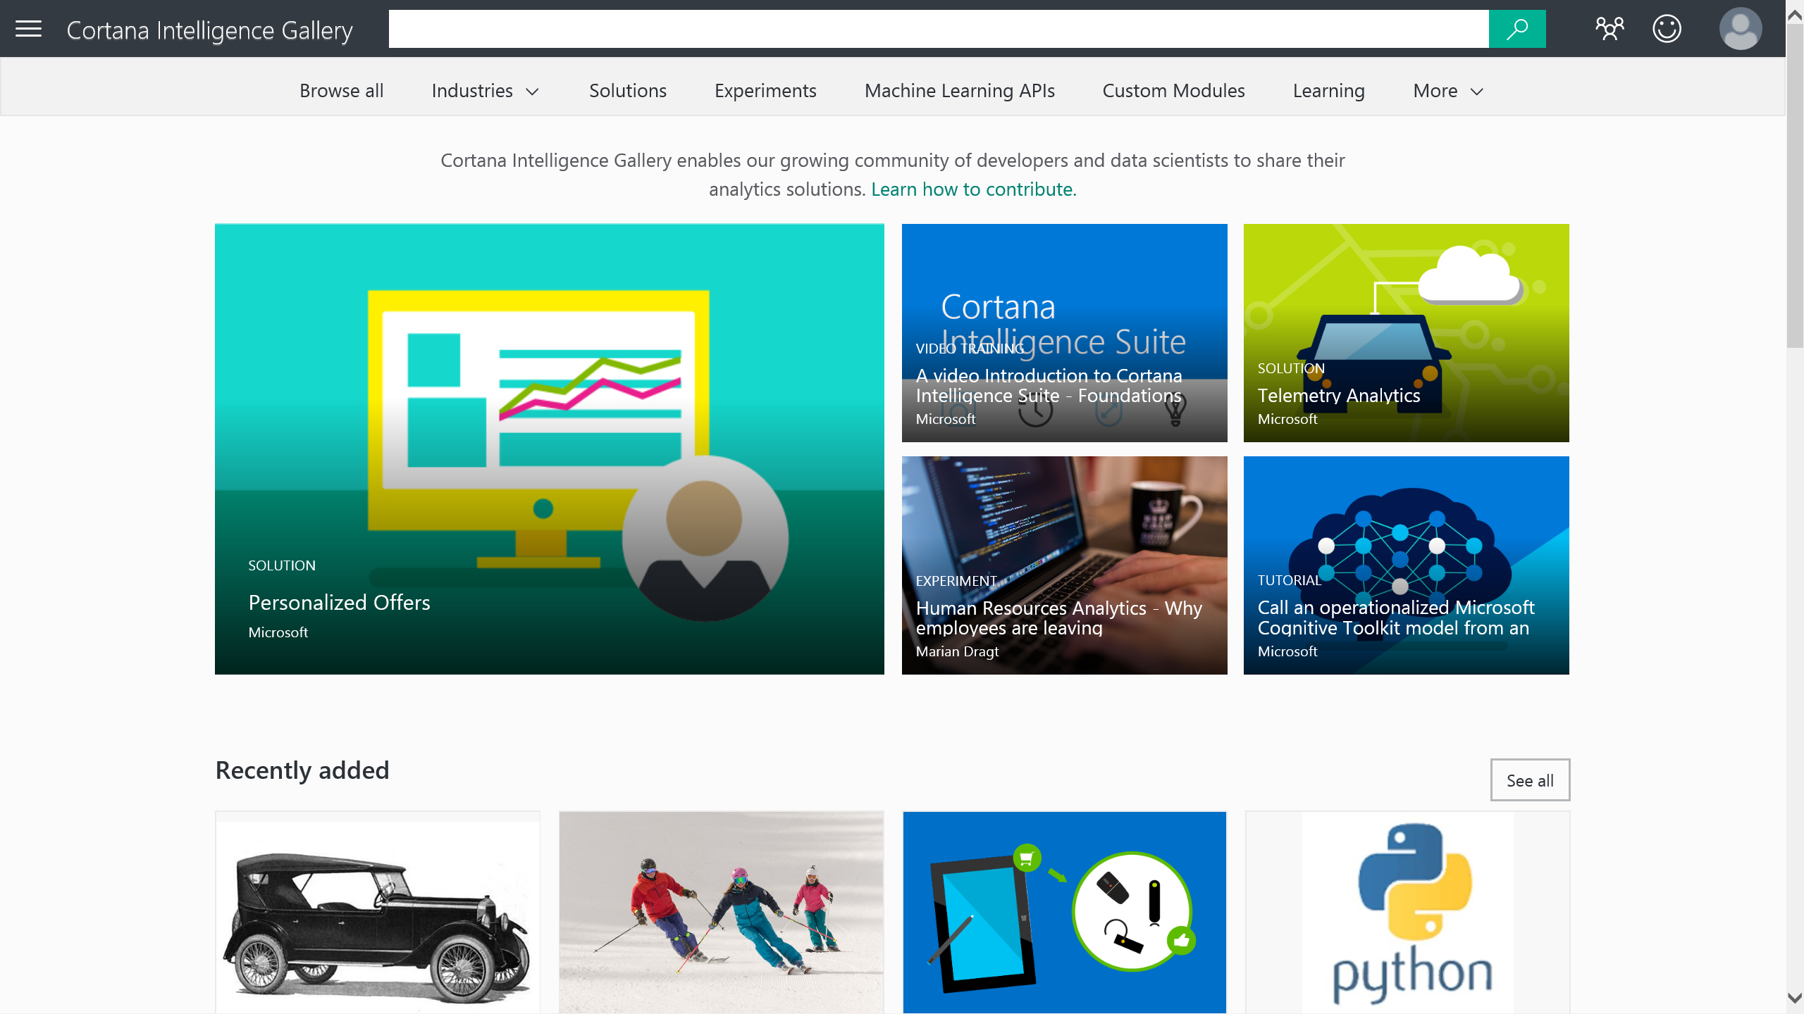
5. Copy other people’s work
Data Science
Cortana Intelligence Gallery (https://gallery.cortanaintelligence.com/)

Slide 34
Agenda
Data Science
Data Science process – TDSP (Team Data Science Process)
Data Science Tools
Hand on Labs

Slide 35
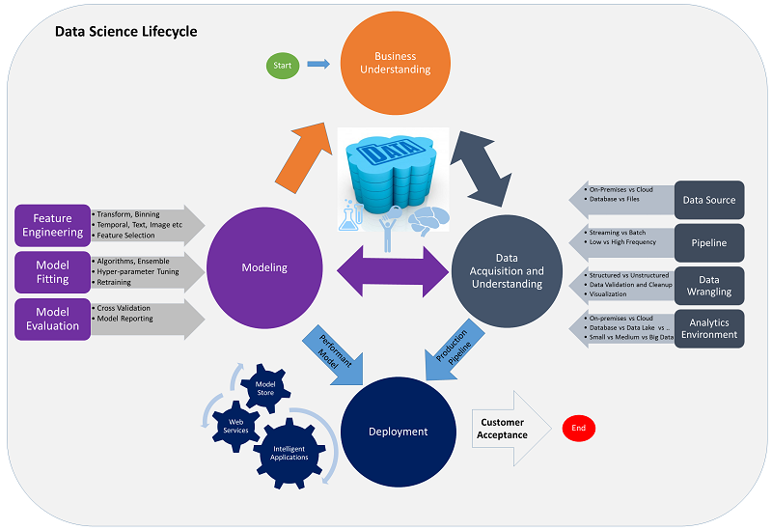
Data Science process – TDSP (Team Data Science Process)
Data Science Lifecycle
Business understanding
Data acquisition and understanding
Modeling
Deployment
Customer Acceptance

Slide 36
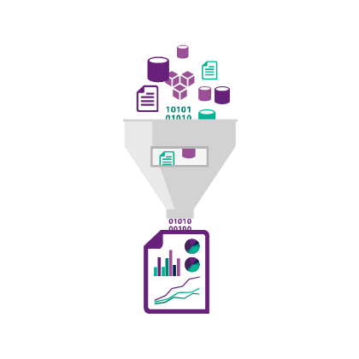
1. Business Understanding
Data Science process – TDSP
Analyze business needs
Define objectives
Identify key business variables
Project goal
Question
Success metrics
Identify data sources
Data sources that contain known examples of answers
Data characteristics
Data quality
Tools and language
Security
Encryption, Audit, Access control
Artifacts
Documents
Data sources
Data

Slide 37
1. Business Understanding
Data Science process – TDSP
Business sample case
Wide World Importers is a company that imports and distributes products in multiple countries around the globe.
With several thousand employees, Information Technology is at the heart of our business operations, and has a significant cost.
Since we handle materials in multiple countries, we have a lot of private data, financial information, and other targets which have a high security profile. We are concerned with both external and internal attacks. In addition, many of our employees work in remote locations, some on ships and other challenging environments.
All of our IT systems have been modernized, and we’re taking in a significant amount of semi-structured data from computing devices – most of it real-time. After talking with our IT leadership, we need a way to determine anomalies within the data streams we get, and have a way to observe the anomalies in a dashboard so that we can respond to outages, threats, and changes quickly.

Slide 38
1. Business Understanding
Data Science process – TDSP
Design statements
Wide World Importers is a company that imports and distributes products in multiple countries around the globe.
With several thousand employees, Information Technology is at the heart of our business operations, and has a significant cost.
Since we handle materials in multiple countries, we have a lot of private data, financial information, and other targets which have a high security profile. We are concerned with both external and internal attacks. In addition, many of our employees work in remote locations, some on ships and other challenging environments.
All of our IT systems have been modernized, and we’re taking in a significant amount of semi-structured data from computing devices – most of it real-time. After talking with our IT leadership, we need a way to determine anomalies within the data streams we get, and have a way to observe the anomalies in a dashboard so that we can respond to outages, threats, and changes quickly.

Slide 39
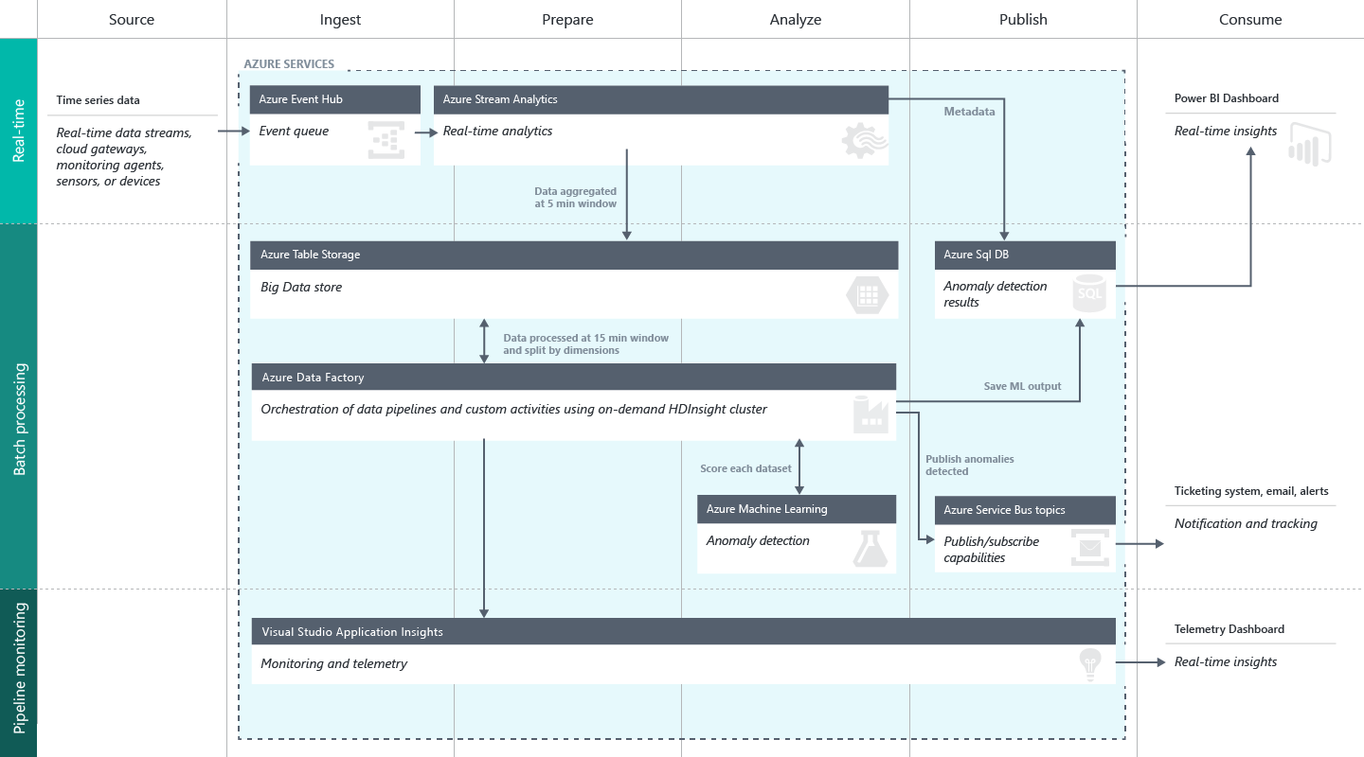
1. Business Understanding
Data Science process – TDSP
Solution Diagram

Slide 40
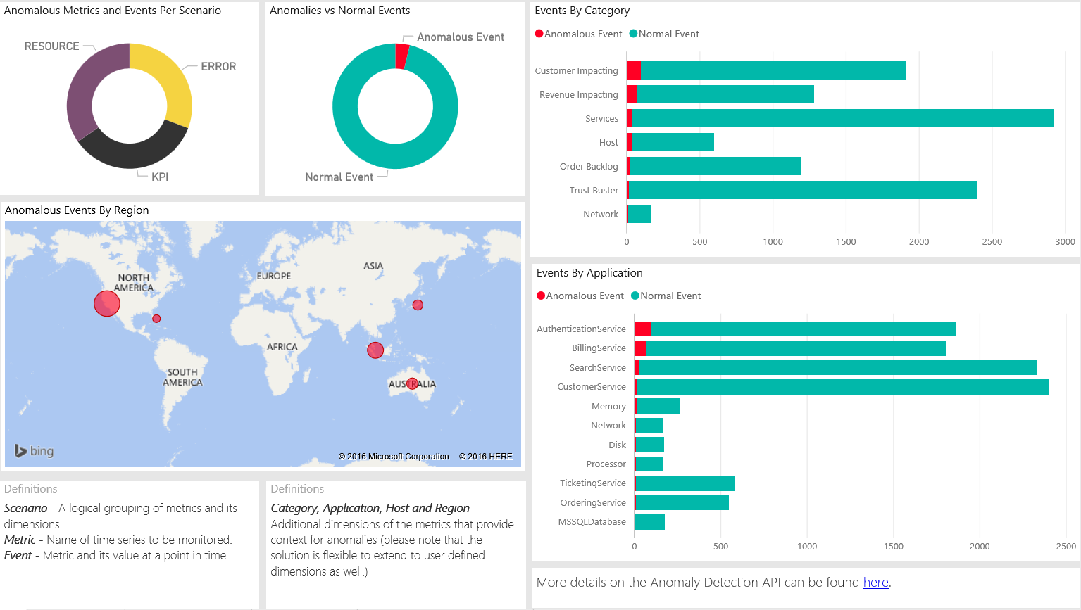
1. Business Understanding
Data Science process – TDSP
Report

Slide 41
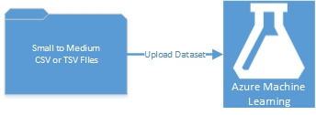
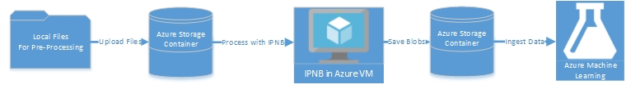
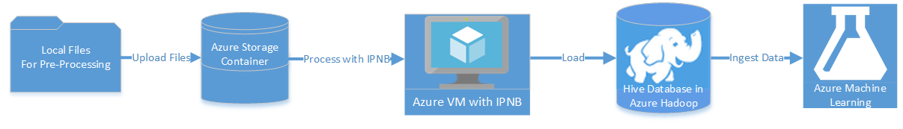
1. Business Understanding
Data Science process – TDSP
Solution Diagram
Scenario #1: Small to medium tabular dataset in a local files
Scenario #2: Small to medium dataset of local files that require processing
Scenario #3: Big data in local files, target Hive database in Azure HDInsight Hadoop clusters

Slide 42
2. Data Acquisition and Understanding
Data Science process – TDSP
Acquire and understand data
Ingest the data
Move the data from source to target location
Explore the data
Data cleaning
Incomplete
Noisy
Inconsistent
Audit the quality of data
Have better understand the patterns
Iterative works
Set up a data pipeline
Score new data
Refresh the data regularly
Pipeline may be batch-based or a streaming or hybrid
Artifacts
Data quality report
Solution architecture
Checkpoint decision

Slide 43
3. Modeling
Data Science process – TDSP
Develop models
Goals
Optimal data features for the machine learning model
Build informative machine learning model that predicts the target most accurately
Experiment for machine learning model that is suitable for production
How to do it
Feature engineering
Aggregate and transform the raw variables to create the features
Requires a creative combination of domain expertise and insights
Model training
How to choose algorithms
Split, Build, Evaluate, Determine the best solution
Artifacts
Feature sets
Modeling report
Checkpoint decision

Slide 44
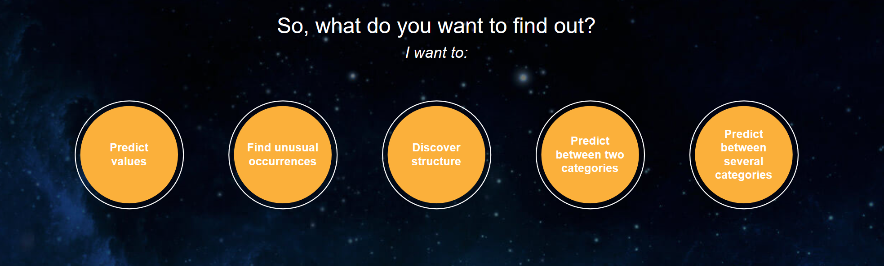
3. Modeling
Data Science process – TDSP
How to choose algorithms
https://azuremlsimpleds.azurewebsites.net/simpleds/

Slide 45
3. Modeling
Data Science process – TDSP
Model Training
Basic Machine Learning Elements
Import Data
Preprocess
Algorithm
Split Data
Train Model
Score Model

Slide 46
4. Deployment
Data Science process – TDSP
Operationalize models
Operationalize the model
Apply trained model to application for real-time or batch basis predictions
Expose the model as API interface to consume it easy
Artifacts
Status dashboard of system health and key metrics
Final modeling report with deployment details
Final solution architecture document

Slide 47
5. Customer Acceptance
Data Science process – TDSP
Finalize the project deliverables
System validation
Confirm the deployed model and pipeline are meeting customer needs
Monitor systems
Project hand-off
Artifacts
Project final report

Slide 48
Data Science process – TDSP
Team Data Science Process Lifecycle
Increase the chance of a successful completion of a complex data science project
Continue to move a data science project forward toward a clear engagement end point
Modeled as a sequence of iterated steps

Slide 49
Agenda
Data Science
Data Science process – TDSP (Team Data Science Process)
Data Science Tools
Hands on Lab

Slide 50
Data Science Tools
Business Understanding
Define Objectives
Identify Data Sources
Data Acquisition and Understanding
Ingest Data
Explore Data
Modeling
Feature Selection
Create and Train Model
Deployment
Customer Acceptance
Operationalize
Testing and Validation
Update Data
Handoff
Re-train and re-score
Big Data
Intelligence and Advanced Analytics
Information Management
Solutions
Visualization
Data Lake
SQL Data Warehouse
Cosmos DB
Cortana, Bot Service, Cognitive Framework
HDInsight
Data Lake
Azure Storage
Stream Analytics
Analysis Services
Power BI
R
Templates and Gallery
Machine Learning
Data Catalog
Data Factory
Event Hubs

Slide 51
Data Science Tools
Business Understanding
Define Objectives
Identify Data Sources
Data Acquisition and Understanding
Ingest Data
Explore Data
Modeling
Feature Selection
Create and Train Model
Deployment
Customer Acceptance
Operationalize
Testing and Validation
Update Data
Handoff
Re-train and re-score
Big Data
Intelligence and Advanced Analytics
Information Management
Solutions
Visualization
Data Lake
SQL Data Warehouse
Cosmos DB
Cortana, Bot Service, Cognitive Framework
HDInsight
Data Lake
Azure Storage
Stream Analytics
Analysis Services
Power BI
R
Templates and Gallery
Machine Learning
Data Catalog
Data Factory
Event Hubs

Slide 52

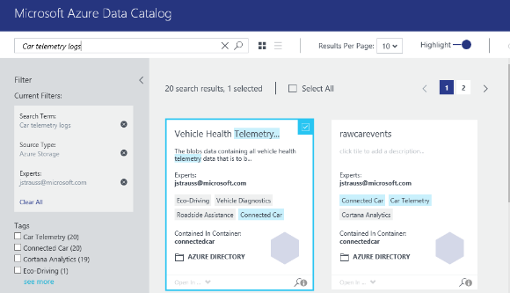
1. Business Understanding
Data Science Tools
Analyze business needs
Find data sources using Azure Data Catalog
Spend less time looking for data, and more time getting value from it
Register enterprise data sources, discover data assets and unlock their potential, and capture tribal knowledge to make data understandable
Bridge the gap between IT and the business, allowing everyone to contribute their insights, tags, and descriptions
Intuitive search and filtering to understand the data sources and their purpose
Let your data live where you want; connect using tools you choose
Integrate into existing tools and processes with open REST APIs

Slide 53
Data Catalog
https://www.azuredatacatalog.com

Slide 54
Data Science Tools
Business Understanding
Define Objectives
Identify Data Sources
Data Acquisition and Understanding
Ingest Data
Explore Data
Modeling
Feature Selection
Create and Train Model
Deployment
Customer Acceptance
Operationalize
Testing and Validation
Update Data
Handoff
Re-train and re-score
Big Data
Intelligence and Advanced Analytics
Information Management
Solutions
Visualization
Data Lake
SQL Data Warehouse
Cosmos DB
Cortana, Bot Service, Cognitive Framework
HDInsight
Data Lake
Azure Storage
Stream Analytics
Analysis Services
Power BI
R
Templates and Gallery
Machine Learning
Data Catalog
Data Factory
Event Hubs

Slide 55
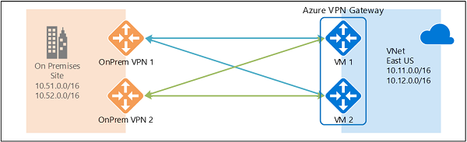
2. Data Acquisition and Understanding
Data Science Tools
Move data via network
Connect on-premises to <anything>
VPN Gateway
Send network traffic from virtual networks to on-prem locations
Send network traffic between virtual networks within Azure
Site-to-site vs. Point-to-site
You can connect multiple on-prem locations to a virtual network (Multi-site)
ExpressRoute can directly connect your WAN to Azure

Slide 56
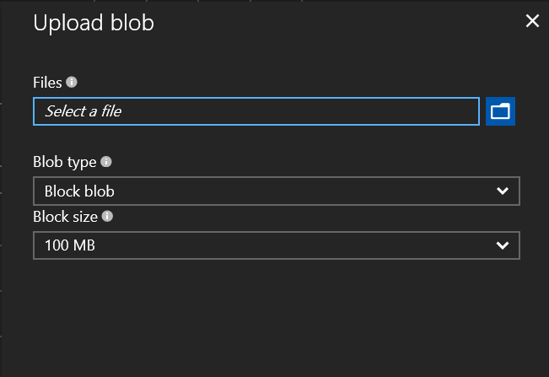
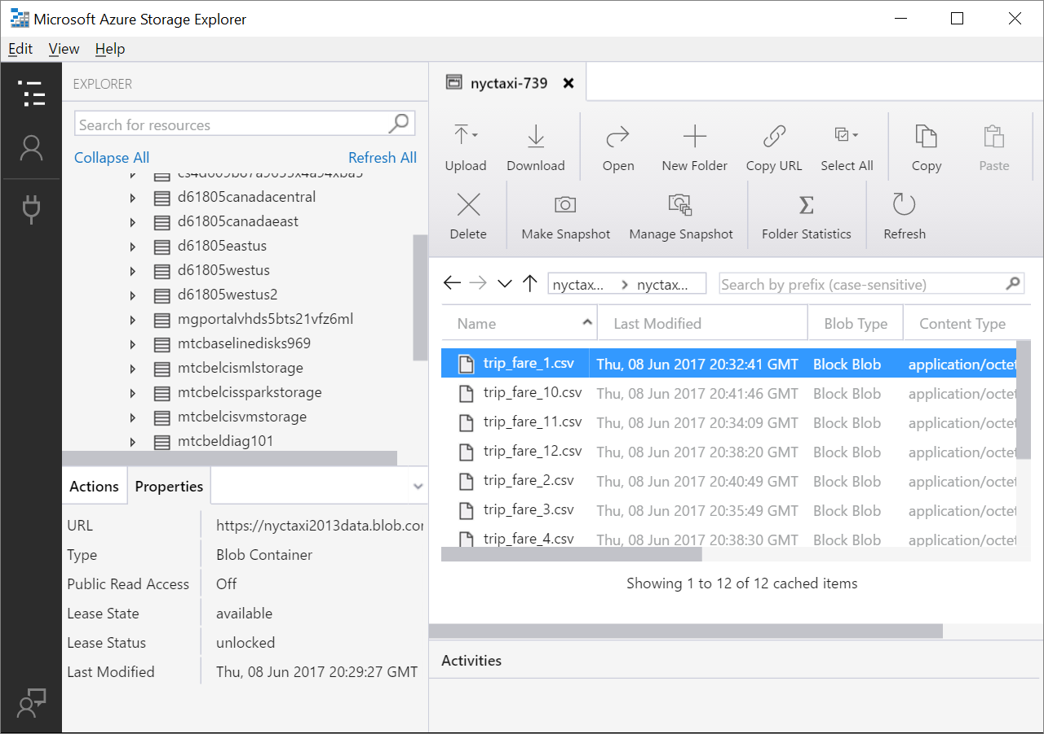
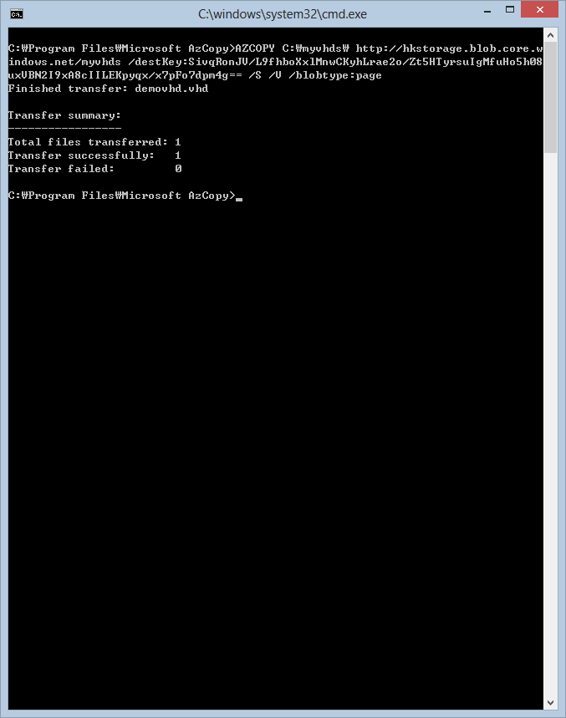
2. Data Acquisition and Understanding
Data Science Tools
Acquire and understand data
Azure portal
PowerShell
Azure Data Factory
Azure Event Hubs
Azure storage SDKs (.NET, Node.js, python, C++, etc.)
AzCopy (blob, file, and table only)
Import/Export service
[ Azure Portal ]
[ Azure Storage Explorer ]
[ AZcopy ]

Slide 57
2. Data Acquisition and Understanding
Data Science Tools
Ingest Data
Azure Data Factory
SQL
INGEST
PREPARE
TRANSFORM & ANALYZE
PUBLISH
DATA SOURCES
SQL
SQL
DATA CONSUMPTION
<>
SQL
{ }
Create, schedule, orchestrate, and manage data pipelines
Visualize data lineage
Connect to on-premises and cloud data sources
Monitor data pipeline health
Automate cloud resource management
Move relational data for Hadoop processing
Transform with Hive, Pig, or custom code

Slide 58



2. Data Acquisition and Understanding
Data Science Tools
Ingest Real-time data
Event Hub
Data sources
SQL Database
Machine Learning
Apps
Azure
API
Management
Storage
HDInsight
Sensors and devices
Event Hubs
Backend Services
Stream Analytics
Power BI
Data
Log millions of events per second in near real time
Connect devices using flexible authorization and throttling
Use time-based event buffering
Get a managed service with elastic scale
Get a managed service with elastic scale
Reach a broad set of platforms using native client libraries
Pluggable adapters for other cloud services

Slide 59
2. Data Acquisition and Understanding
Data Science Tools
Store data
Unstructured data such as media files, logs, binary data, backups
Metadata (e.g. user info), in key-value format, fast and easy to query
Messaging between components of your application
Shared file systems option – when your application is already built to use a SMB protocol
{‘name’: Sue,
‘role’: 'admin’,
‘status’: ‘active’,
‘location’: ‘WA’
Blob
Table
Queue
File

Slide 60



2. Data Acquisition and Understanding
Data Science Tools
Store data
A hyper-scale repository for big data analytics workloads
Devices
Social
ADL Analytics
LOB Applications
Video
HDInsight
ADL Store
R
Web
Sensors
Spark
Relational
Clickstream
Machine Learning
A Hadoop Distributed File System for the cloud
No fixed limits on file size
No fixed limits on account size
Unstructured and structured data in their native format
Massive throughput to increase analytic performance
High durability, availability, and reliability
Azure Active Directory access control

Slide 61

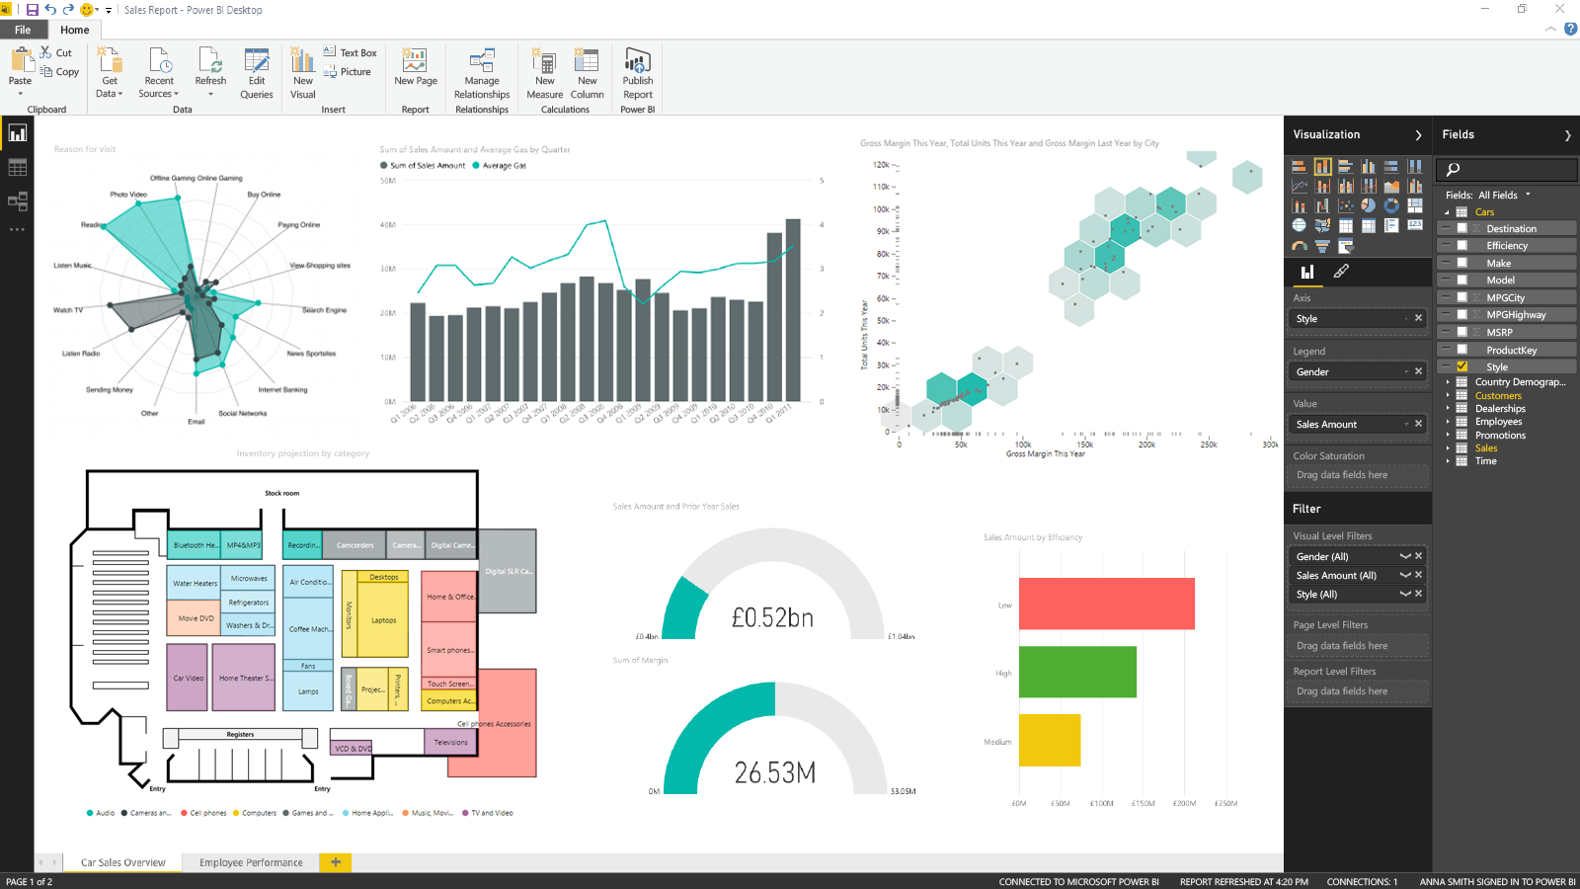
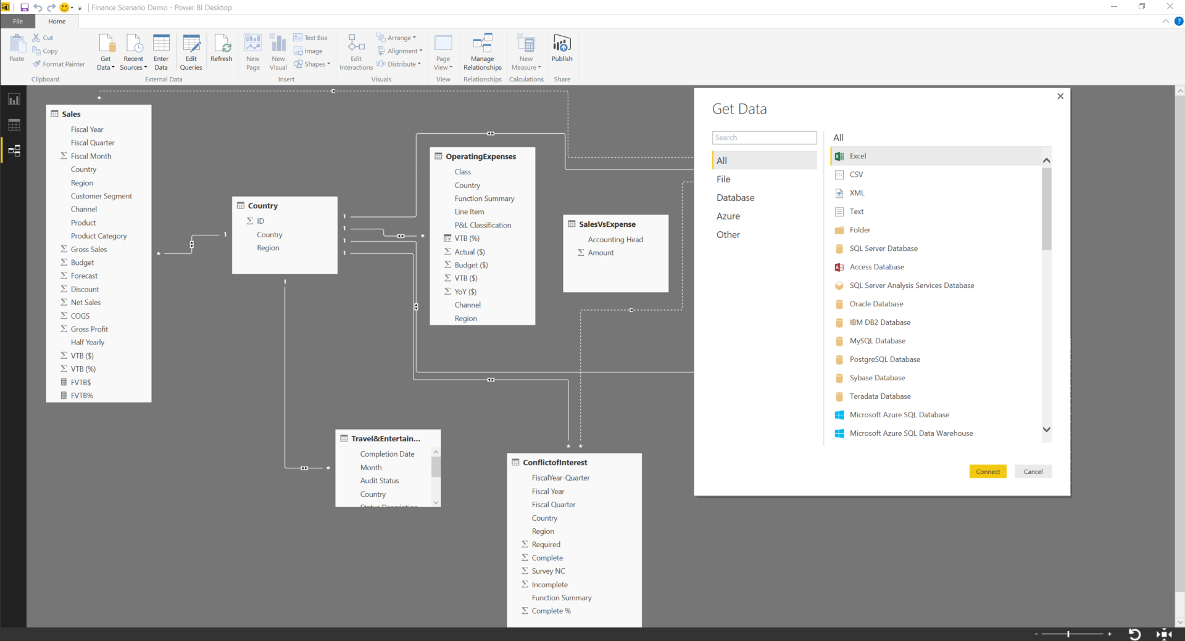
2. Data Acquisition and Understanding
Data Science Tools
Tools to understand data
Excel/PowerBI

Slide 62
PowerBI
Visualize SQL DB data

Slide 63
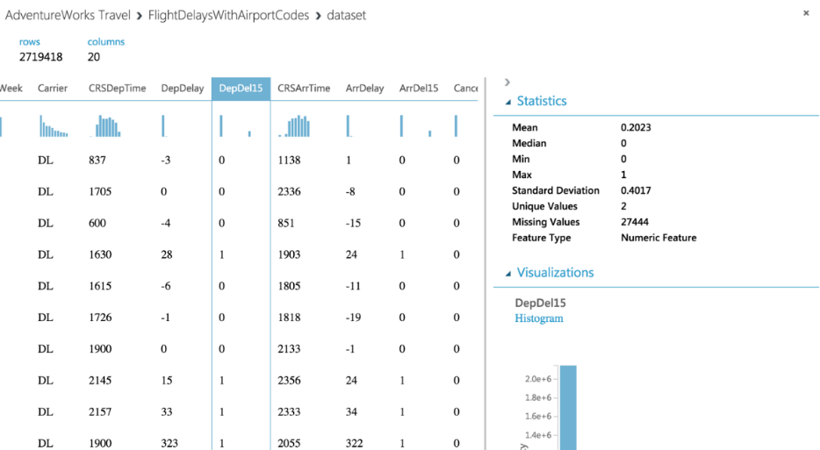
2. Data Acquisition and Understanding
Data Science Tools
Tools to understand data
Azure Machine Learning

Slide 64
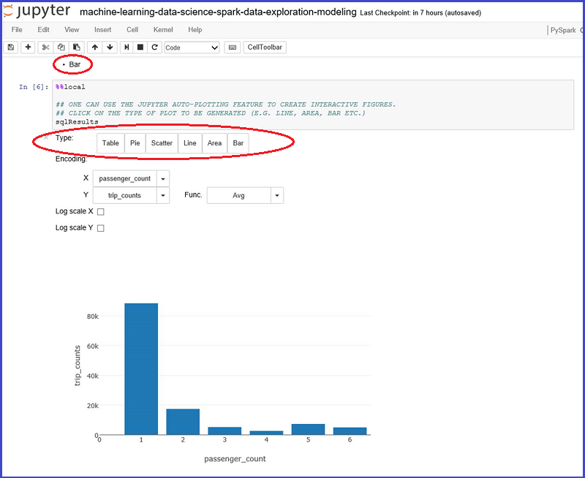
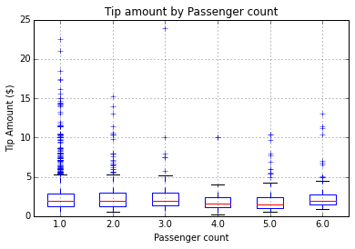
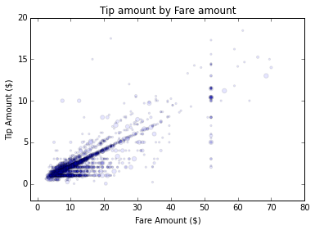
2. Data Acquisition and Understanding
Data Science Tools
Tools to understand data
Azure Notebooks (https://notebooks.azure.com/)

Slide 65
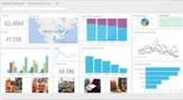
2. Data Acquisition and Understanding
Data Science Tools
Process data
Elastic data warehouse as a service with enterprise-class features
Power BI
Hadoop
App Service
SQL Database
SQL Data Warehouse
Intelligent App
Machine Learning
Petabyte scale with massively parallel processing
Independent scaling of compute and storage—in seconds
Transact-SQL queries across relational and non-relational data
Full enterprise-class SQL Server experience
Works seamlessly with Power BI, Machine Learning, HDInsight, and Data Factory

Slide 66



2. Data Acquisition and Understanding
Data Science Tools
Process data
Big data analytics made easy
Data Lake Analytics
SQL DW
SQL DB
Data Lake Store
Storage Blobs
SQL DB in a VM
Analyze data of any kind and size
Develop faster, debug and optimize smarter
Interactively explore patterns in your data
No learning curve—use U-SQL, Spark, Hive, HBase and Storm
Managed and supported with an enterprise-grade SLA
Dynamically scales to match your business priorities
Enterprise-grade security with Azure Active Directory
Built on YARN, designed for the cloud

Slide 67
Data Science Tools
Business Understanding
Define Objectives
Identify Data Sources
Data Acquisition and Understanding
Ingest Data
Explore Data
Modeling
Feature Selection
Create and Train Model
Deployment
Customer Acceptance
Operationalize
Testing and Validation
Update Data
Handoff
Re-train and re-score
Big Data
Intelligence and Advanced Analytics
Information Management
Solutions
Visualization
Data Lake
SQL Data Warehouse
Cosmos DB
Cortana, Bot Service, Cognitive Framework
HDInsight
Data Lake
Azure Storage
Stream Analytics
Analysis Services
Power BI
R
Templates and Gallery
Machine Learning
Data Catalog
Data Factory
Event Hubs

Slide 68
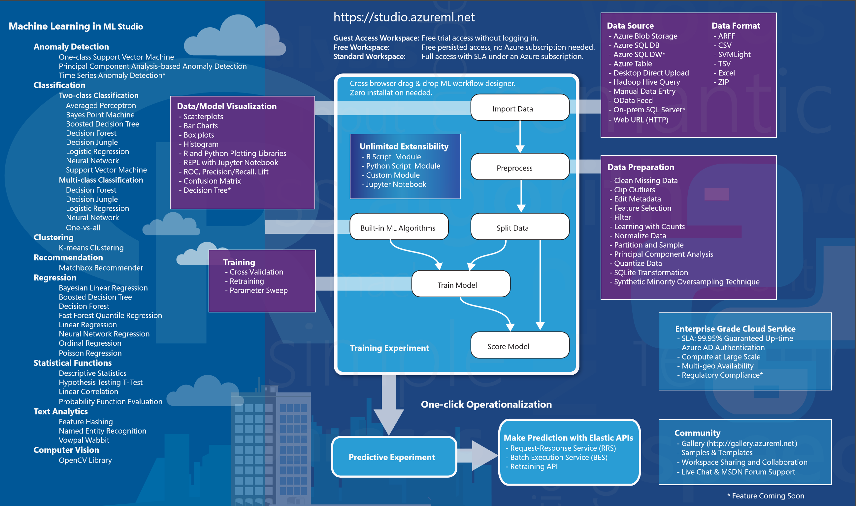
3. Modeling
Data Science Tools
Develop models

Slide 69
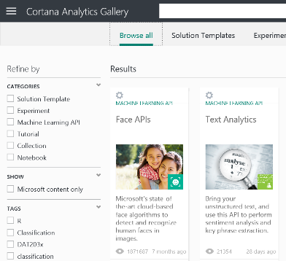
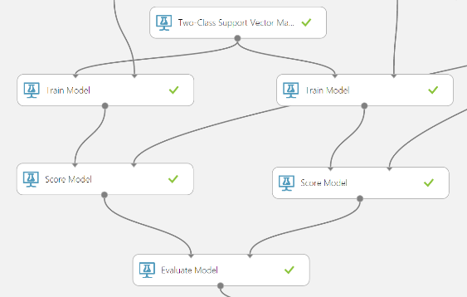
3. Modeling
Data Science Tools
Develop models
Azure Machine Learning
Simple, scalable, cutting edge. A fully managed cloud service that enables you to easily build, deploy, and share predictive analytics solutions.
Deploy in minutes. Azure Machine Learning means business. You can deploy your model into production as a web service that can be called from any device, anywhere and that can use any data source.
Publish, share, monetize. Share your solution with the world in the Gallery or on the Azure Marketplace.

Slide 70



3. Modeling
Data Science Tools
Develop models
HDInsight Spark

Slide 71

3. Modeling
Data Science Tools
R and Python

Slide 72
3. Modeling
Data Science Tools
Machine Learning Algorithms
Split into two main categories
Supervised learning
Predicting the future
Learn from known past examples to predict future
Labels provided
Unsupervised learning
Making sense of data
Understanding the past
Learning the structure of data
Labels no provided

Slide 73
Data Science Tools
Business Understanding
Define Objectives
Identify Data Sources
Data Acquisition and Understanding
Ingest Data
Explore Data
Modeling
Feature Selection
Create and Train Model
Deployment
Customer Acceptance
Operationalize
Testing and Validation
Update Data
Handoff
Re-train and re-score
Big Data
Intelligence and Advanced Analytics
Information Management
Solutions
Visualization
Data Lake
SQL Data Warehouse
Cosmos DB
Cortana, Bot Service, Cognitive Framework
HDInsight
Data Lake
Azure Storage
Stream Analytics
Analysis Services
Power BI
R
Templates and Gallery
Machine Learning
Data Catalog
Data Factory
Event Hubs

Slide 74

4. Deployment
Data Science Tools
Operationalize models
Azure Machine Learning - Publish as a Web Service

Slide 75





4. Deployment
Data Science Tools
Operationalize models
App Services
API App
Logic App
Mobile App
Web App

Slide 76

4. Deployment
Data Science Tools
Get things done in more helpful, proactive and natural ways
Bot Connector Service: A service to register your bot, configure channels and publish to the Bot Directory. Connect your bot(s) seamlessly to text/sms, Office 365 mail, Skype, Slack, Twitter, and more.
Bot Builder SDK: An open source SDK hosted on GitHub. Everything you need to build great dialogs within your Node.js or C# bot
Bot Directory: A public directory of bots registered through the Bot Connector Service. Discover, try, and add bots to conversation experiences

Slide 77

4. Deployment
Data Science Tools
Get things done in more helpful, proactive and natural ways
Here are some of the things I can help you with…
Cortana for Consumers (today)
With the Cortana Intelligence Suite
Answers
Public reference data answers – “How far is it from Los Angeles to San Francisco?”
Answers from organizational data in Power BI
“What were our biggest deals that closed last month?”
Predictions
Event predictions – “Who do you think is going to win the Germany Italy game?”
Integration with prediction solutions
“Which of our customers are most likely to churn in the next quarter?”
Monitoring & Alerts
Flight status, traffic conditions, changes in weather, …
Monitoring KPIs and preemptive alerting
“Alert me if this customer ever has a 90% chance of churn in the next 30 days”
Task Completion
Setting reminders, scheduling meetings, getting directions, …
Line of business process integration
Assistance with expense report submission on-time within policy

Slide 78

4. Deployment
Data Science Tools
Report
Power BI
A Reporting System for Multiple Data Sources
Available in:
Web Portal
Power BI Desktop
Microsoft Excel
Mobile apps (iOS, Android, Windows)
Author
Connect to Data
Shape the Data
Model the Data
Report on the Data
Publish
Local
To Service

Slide 79
Data Science Tools
Business Understanding
Define Objectives
Identify Data Sources
Data Acquisition and Understanding
Ingest Data
Explore Data
Modeling
Feature Selection
Create and Train Model
Deployment
Customer Acceptance
Operationalize
Testing and Validation
Update Data
Handoff
Re-train and re-score
Big Data
Intelligence and Advanced Analytics
Information Management
Solutions
Visualization
Data Lake
SQL Data Warehouse
Cosmos DB
Cortana, Bot Service, Cognitive Framework
HDInsight
Data Lake
Azure Storage
Stream Analytics
Analysis Services
Power BI
R
Templates and Gallery
Machine Learning
Data Catalog
Data Factory
Event Hubs

Slide 80
Agenda
Data Science
Data Science process – TDSP (Team Data Science Process)
Data Science Tools
Hands on Lab

Slide 81
Create Data Science Virtual Machine
Hands on lab
http://bit.ly/2saZqqi
Notes:
https://docs.microsoft.com/en-us/azure/machine-learning/machine-learning-data-science-virtual-machine-overview

Slide 82
Azure Machine Learning (1)
Hands on lab
http://bit.ly/2qtrDHx
Notes:
http://bit.ly/2fQaOwM
https://docs.microsoft.com/en-us/azure/machine-learning/machine-learning-create-experiment

Slide 83
Azure Machine Learning (2)
Hands on lab
http://bit.ly/2fQaOwM
Notes:
http://bit.ly/2qtrDHx

Slide 85
Appendix
Data Science for Beginners
https://docs.microsoft.com/en-us/azure/machine-learning/machine-learning-data-science-for-beginners-the-5-questions-data-science-answers
R quick start
https://cran.r-project.org/doc/contrib/Paradis-rdebuts_en.pdf
https://docs.microsoft.com/en-us/azure/machine-learning/machine-learning-r-quickstart
Setup Data Science Virtual Machine
https://docs.microsoft.com/en-us/azure/machine-learning/machine-learning-data-science-virtual-machine-overview

